Slide 1

Math’s 12
Integration and the fundamental theorem of calculus

Slide 2
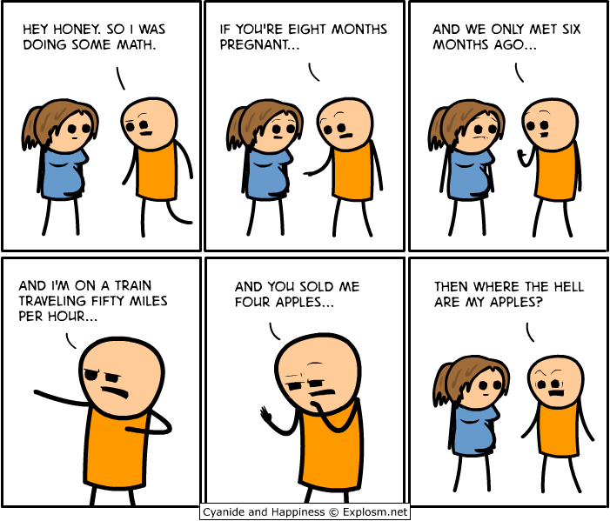
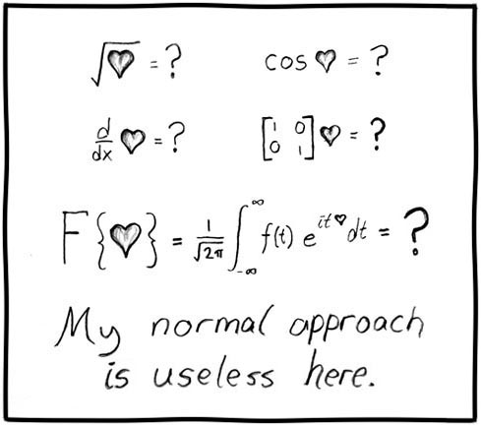
Area Under Curve
I’m just putting vaguely maths things in now.

Slide 3
Area Under Curve
I’ve previously told you that integration is about finding the area under a curve.
This can be useful for various purposes in science particularly when you need to estimate the total or average value of a function.

Slide 4
Area Under Curve
First we need to understand indefinite and definite integrals.
We have previously been using indefinite integrals. These are integrals of the function through infinity.
When you want to work out things like the area under the curve you cannot do it to infinity but need a subset.

Slide 5
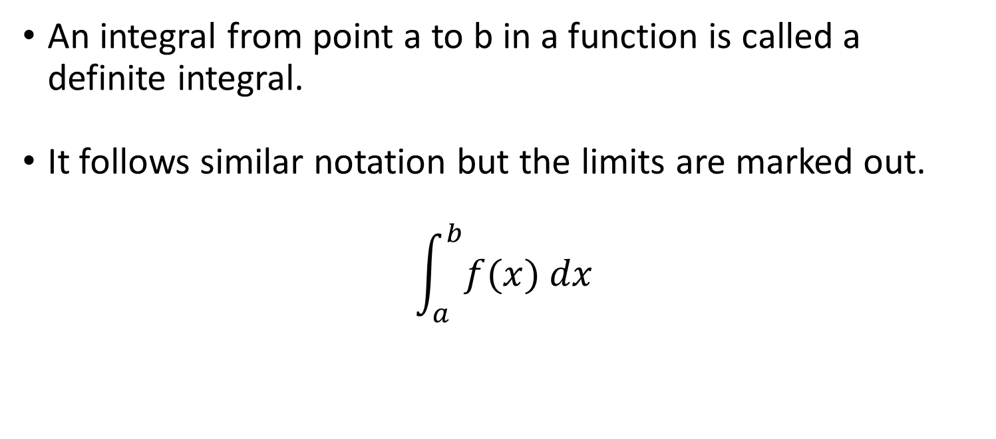
Area Under Curve
An integral from point a to b in a function is called a definite integral.
It follows similar notation but the limits are marked out.
$$\int_{a}^{b}{f(x) dx}$$

Slide 6
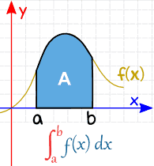

Area Under Curve
An integral from point a to b in a function is called a definite integral.
$$\int_{a}^{b}{f(x) dx}$$

Slide 7

Area Under Curve
So lets look at what the indefinite integral of the function y = 2x is between 1 and 2.
$$\int_{1}^{2}{2x dx}$$

Slide 8
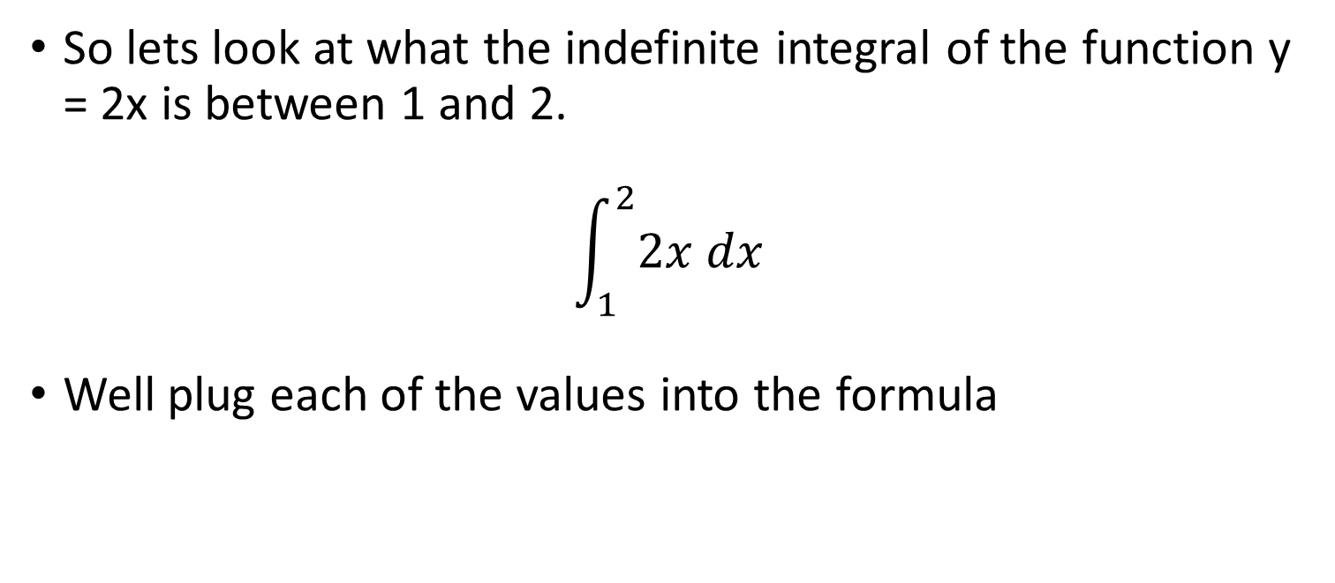
Area Under Curve
So lets look at what the indefinite integral of the function y = 2x is between 1 and 2.
$$\int_{1}^{2}{2x dx}$$
Well plug each of the values into the formula

Slide 9
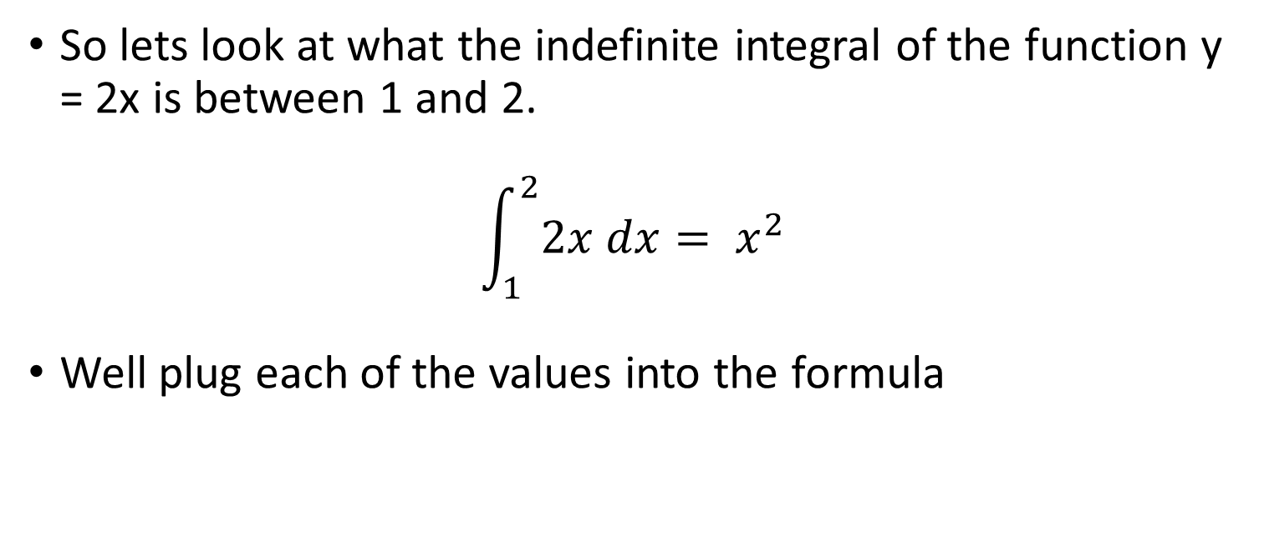
Area Under Curve
So lets look at what the indefinite integral of the function y = 2x is between 1 and 2.
$$\int_{1}^{2}{2x dx}= x^{2}$$
Well plug each of the values into the formula

Slide 10
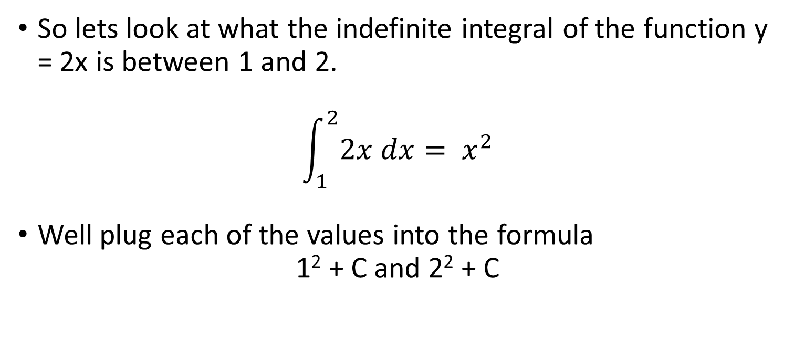
Area Under Curve
So lets look at what the indefinite integral of the function y = 2x is between 1 and 2.
$$\int_{1}^{2}{2x dx}= x^{2}$$
Well plug each of the values into the formula
1² + C and 2² + C

Slide 11
Area Under Curve
1² + C and 2² + C
It’s an area problem so the area at the later point – the area at the starting point.
(4 + C) – (1 + C)

Slide 12
Area Under Curve
1² + C and 2² + C
It’s an area problem so the area at the later point – the area at the starting point.
(4 + C) – (1 + C)
4 – 1 + C – C

Slide 13
Area Under Curve
1² + C and 2² + C
It’s an area problem so the area at the later point – the area at the starting point.
(4 + C) – (1 + C)
4 – 1 + C – C
Hey look the constants cancel out!

Slide 14
Area Under Curve
1² + C and 2² + C
It’s an area problem so the area at the later point – the area at the starting point.
(4 + C) – (1 + C)
4 – 1 + C – C = 3
We can ignore the constant when dealing with definites

Slide 15
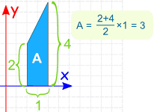

Area Under Curve
$$\int_{1}^{2}{2x dx}=3$$
This value is the area under the curve. We can see that from.

Slide 16
Area Under Curve
We can do this with other examples and things can get a bit complicated with negative areas due to crossing axes etc.
Lets try a couple more to get a hang of it.

Slide 17
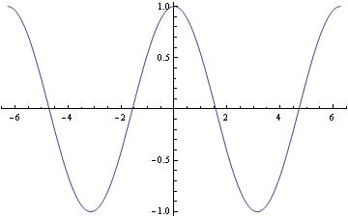
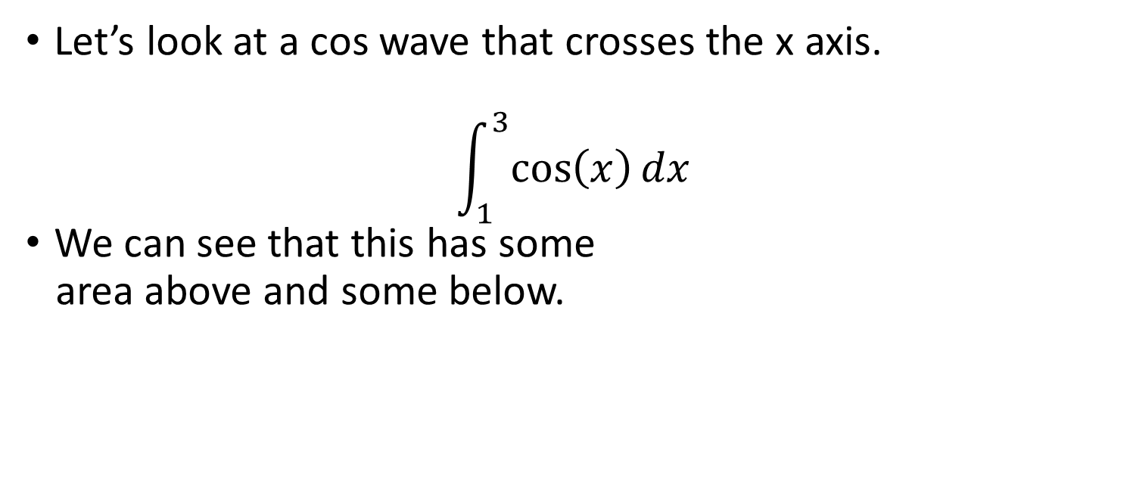
Area Under Curve
Let’s look at a cos wave that crosses the x axis.
$$\int_{1}^{3}{\cos\left(x\right)dx}$$
We can see that this has some
area above and some below.

Slide 18
Area Under Curve
Let’s look at a cos wave that crosses the x axis.
$$\int_{1}^{3}{\cos\left(x\right)dx}$$
We can see that this has some
area above and some below.

Slide 19
Area Under Curve
Let’s look at a cos wave that crosses the x axis.
$$\int_{1}^{3}{\cos\left(x\right)dx}$$
We can see that this has some
area above and some below.

Slide 20
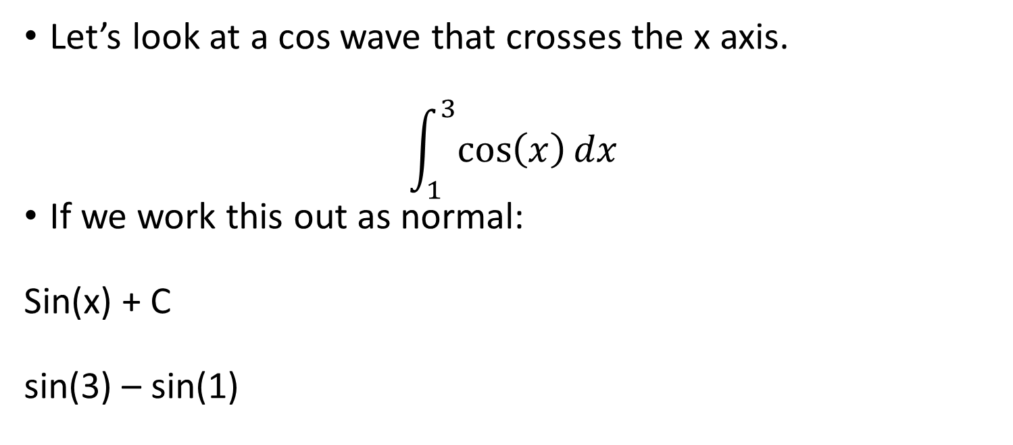
Area Under Curve
Let’s look at a cos wave that crosses the x axis.
$$\int_{1}^{3}{\cos\left(x\right)dx}$$
If we work this out as normal:
Sin(x) + C
sin(3) – sin(1)

Slide 21
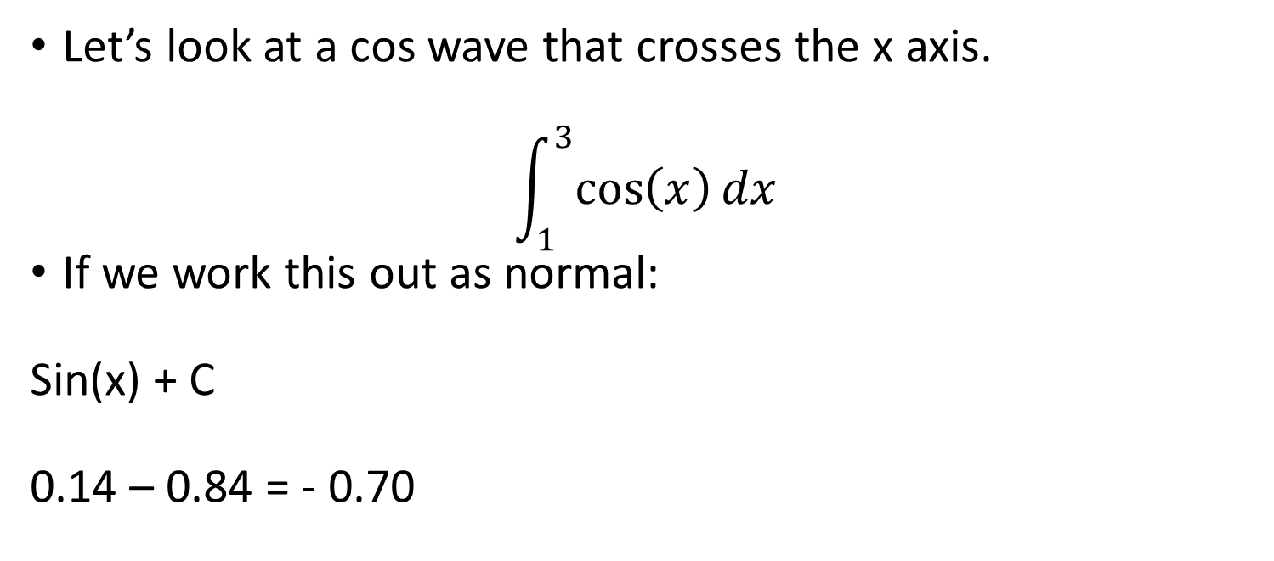
Area Under Curve
Let’s look at a cos wave that crosses the x axis.
$$\int_{1}^{3}{\cos\left(x\right)dx}$$
If we work this out as normal:
Sin(x) + C
0.14 – 0.84 = - 0.70

Slide 22
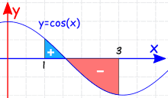
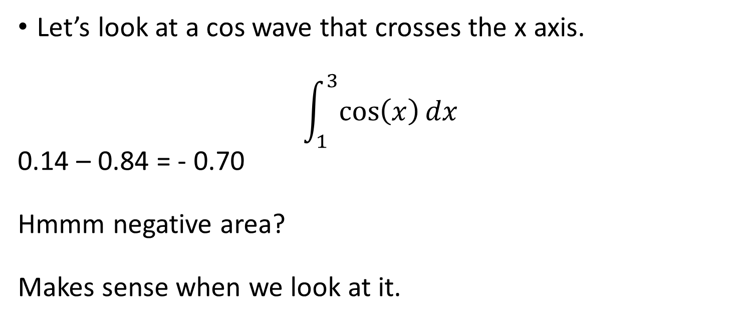
Area Under Curve
Let’s look at a cos wave that crosses the x axis.
$$\int_{1}^{3}{\cos\left(x\right)dx}$$
0.14 – 0.84 = - 0.70
Hmmm negative area?
Makes sense when we look at it.

Slide 23
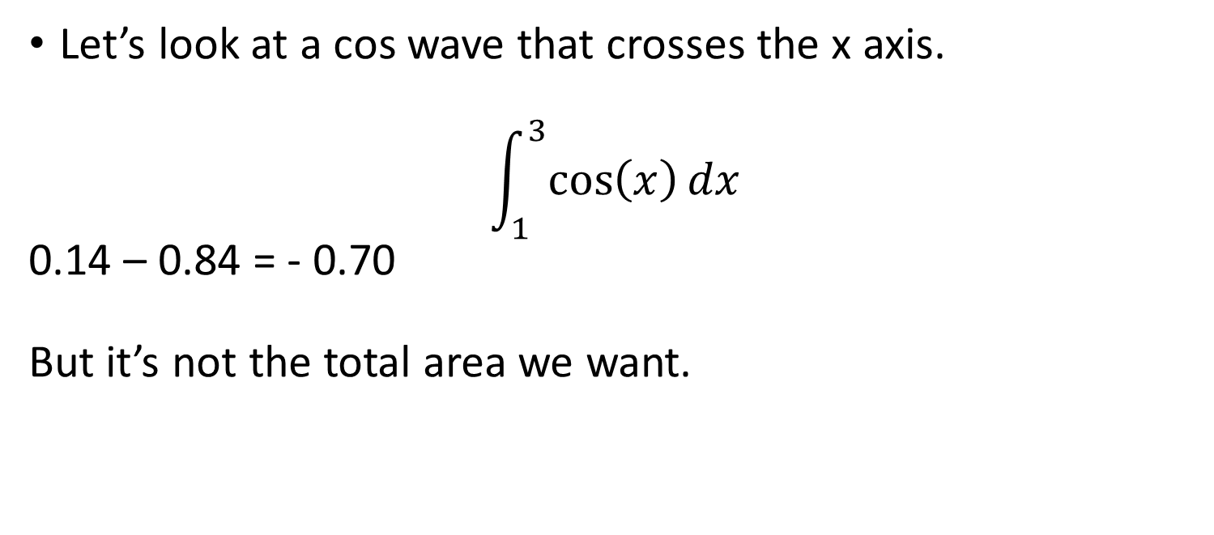
Area Under Curve
Let’s look at a cos wave that crosses the x axis.
$$\int_{1}^{3}{\cos\left(x\right)dx}$$
0.14 – 0.84 = - 0.70
But it’s not the total area we want.

Slide 24
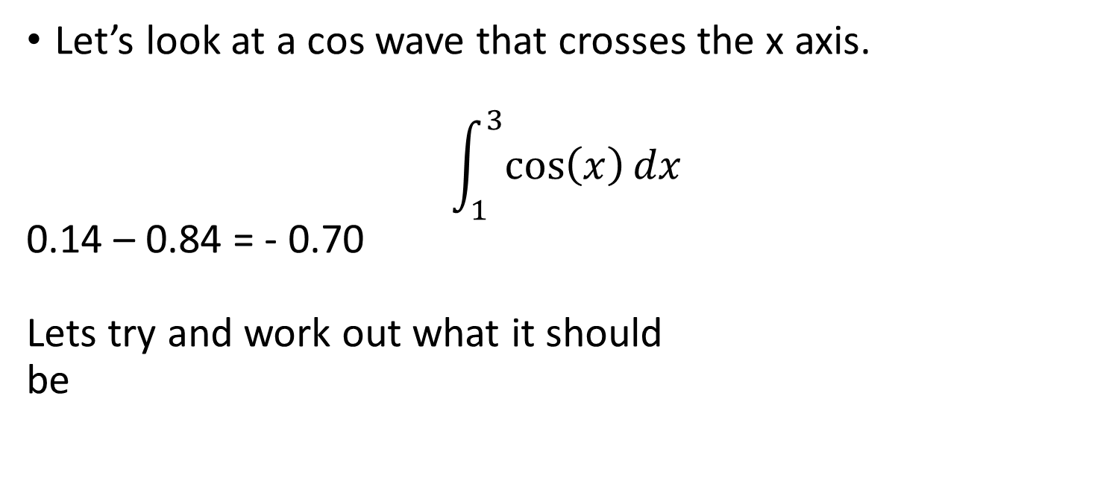
Area Under Curve
Let’s look at a cos wave that crosses the x axis.
$$\int_{1}^{3}{\cos\left(x\right)dx}$$
0.14 – 0.84 = - 0.70
Lets try and work out what it should
be

Slide 25
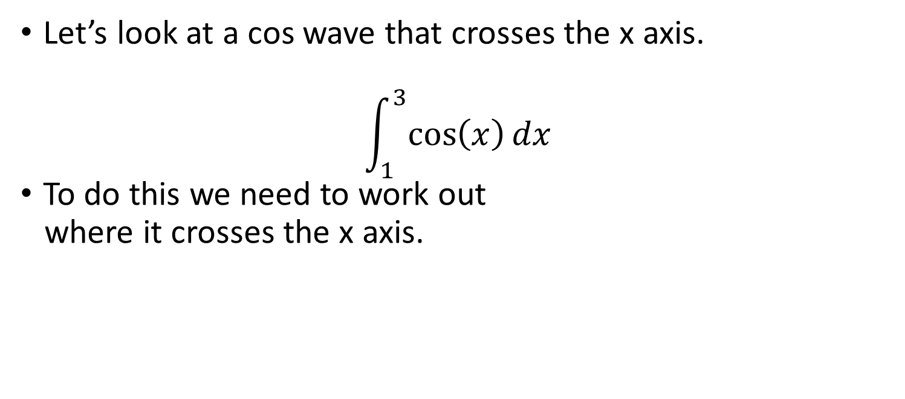
Area Under Curve
Let’s look at a cos wave that crosses the x axis.
$$\int_{1}^{3}{\cos\left(x\right)dx}$$
To do this we need to work out
where it crosses the x axis.

Slide 26
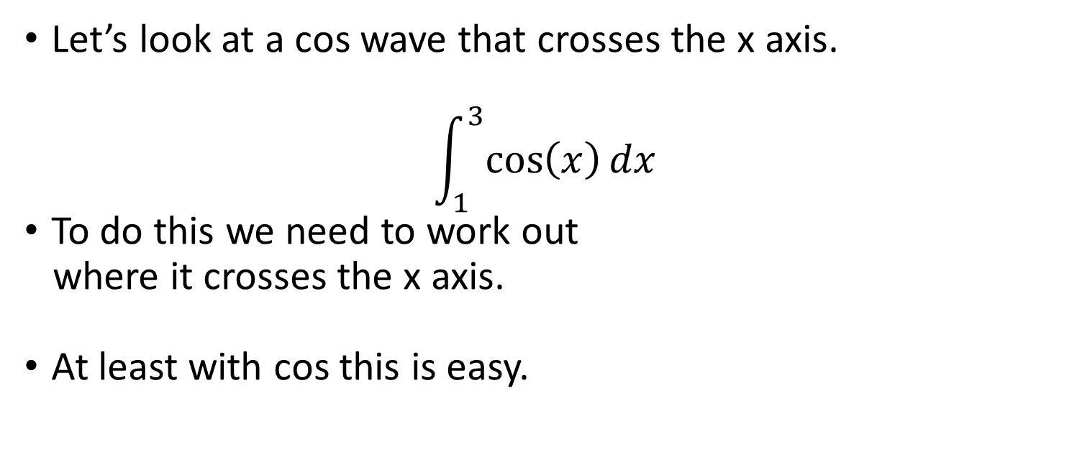
Area Under Curve
Let’s look at a cos wave that crosses the x axis.
$$\int_{1}^{3}{\cos\left(x\right)dx}$$
To do this we need to work out
where it crosses the x axis.
At least with cos this is easy.

Slide 27
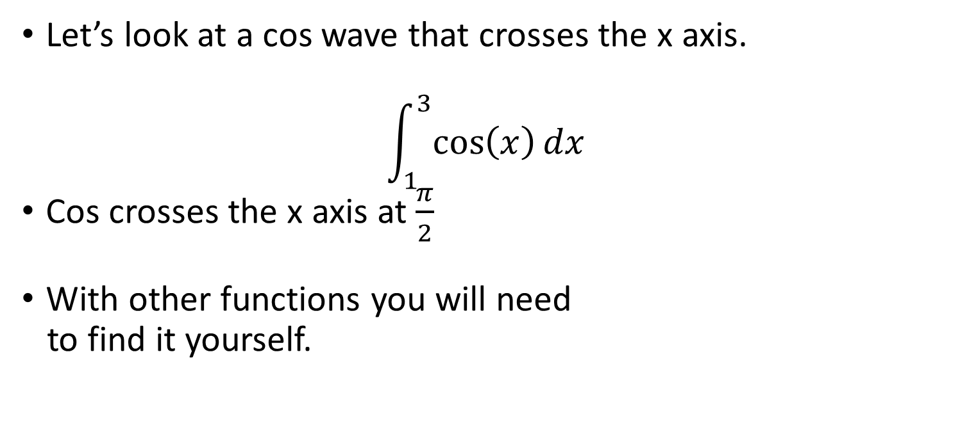
Area Under Curve
Let’s look at a cos wave that crosses the x axis.
$$\int_{1}^{3}{\cos\left(x\right)dx}$$
Cos crosses the x axis at $\frac{π}{2}$
With other functions you will need
to find it yourself.

Slide 28
Area Under Curve
Let’s look at a cos wave that crosses the x axis.
$$\int_{1}^{3}{\cos\left(x\right)dx}$$
Cos crosses the x axis at $\frac{π}{2}$
With other functions you will need
to find it yourself.

Slide 29
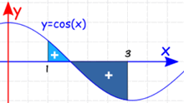
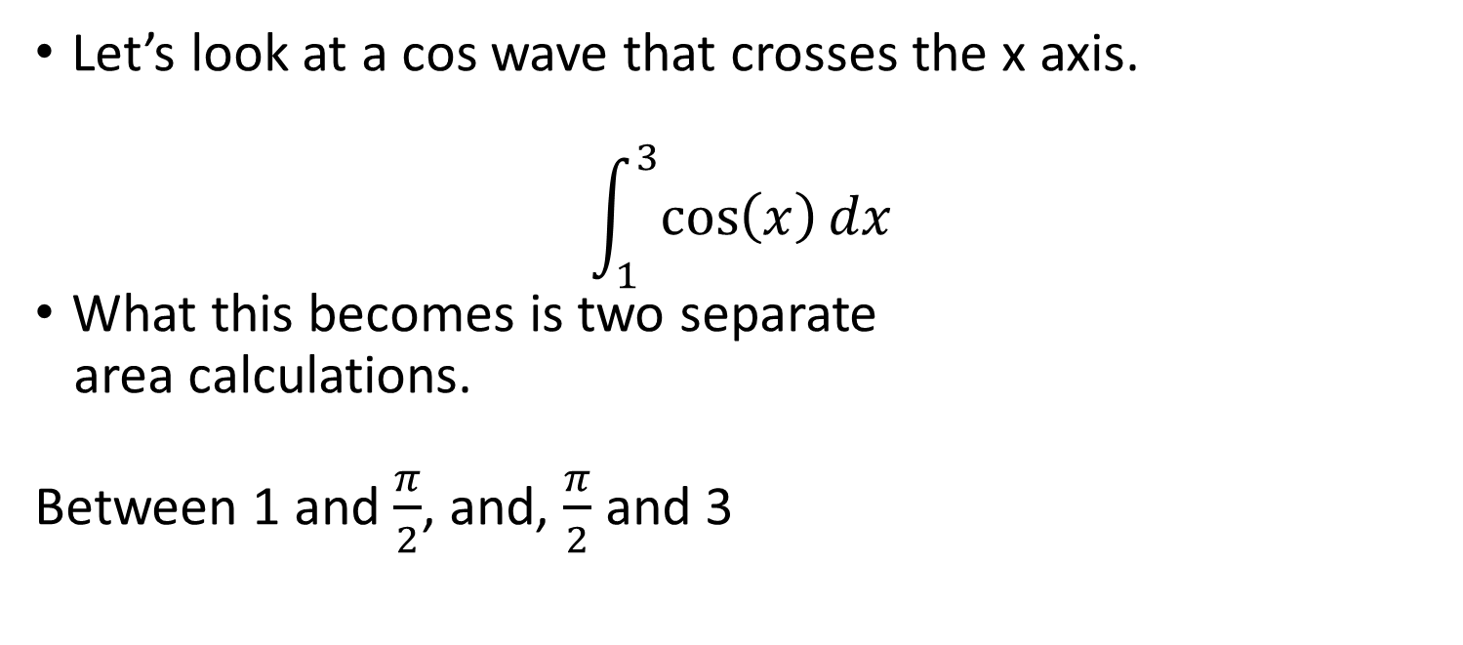
Area Under Curve
Let’s look at a cos wave that crosses the x axis.
$$\int_{1}^{3}{\cos\left(x\right)dx}$$
What this becomes is two separate
area calculations.
Between 1 and $\frac{π}{2}$, and, $\frac{π}{2}$ and 3

Slide 30
Area Under Curve
Let’s look at a cos wave that crosses the x axis.
$$\int_{1}^{3}{\cos\left(x\right)dx}$$
What this becomes is two separate
area calculations.
Between 1 and $\frac{π}{2}$, and, $\frac{π}{2}$ and 3

Slide 31

Area Under Curve
Let’s look at a cos wave that crosses the x axis.
$$\int_{1}^{3}{\cos\left(x\right)dx}$$
sin($\frac{π}{2}$) – sin(1) = 1 – 0.84

Slide 32

Area Under Curve
Let’s look at a cos wave that crosses the x axis.
$$\int_{1}^{3}{\cos\left(x\right)dx}$$
sin($\frac{π}{2}$) – sin(1) = 1 – 0.84 = 0.16

Slide 33
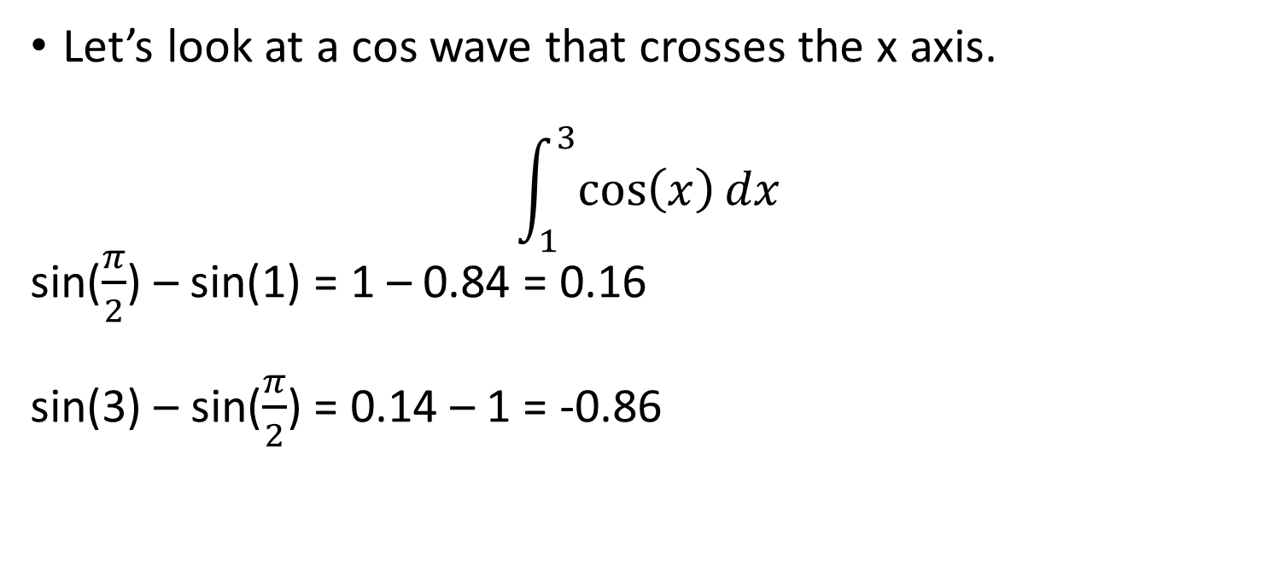
Area Under Curve
Let’s look at a cos wave that crosses the x axis.
$$\int_{1}^{3}{\cos\left(x\right)dx}$$
sin($\frac{π}{2}$) – sin(1) = 1 – 0.84 = 0.16
sin(3) – sin($\frac{π}{2}$) = 0.14 – 1 = -0.86

Slide 34
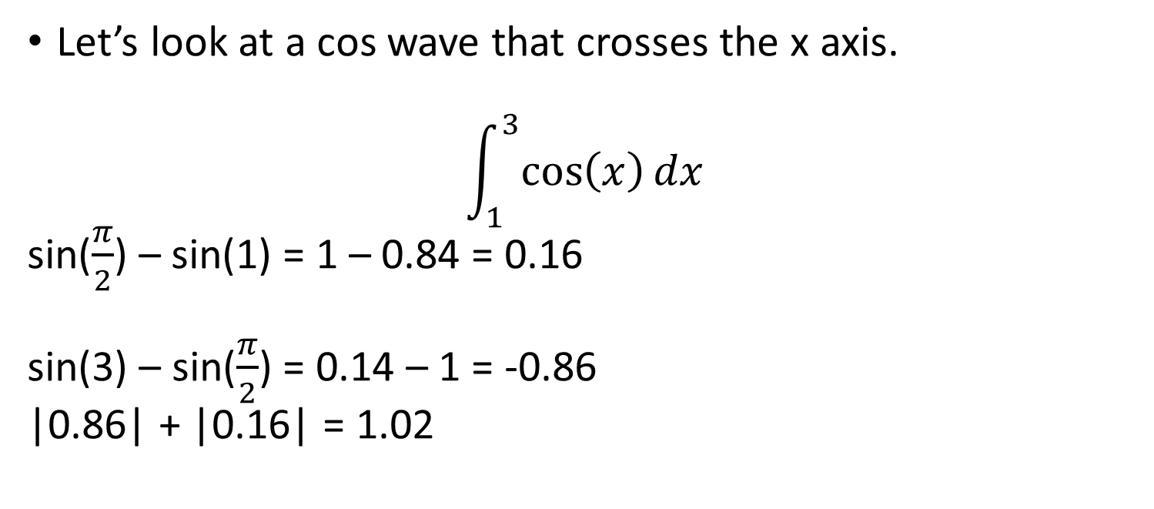
Area Under Curve
Let’s look at a cos wave that crosses the x axis.
$$\int_{1}^{3}{\cos\left(x\right)dx}$$
sin($\frac{π}{2}$) – sin(1) = 1 – 0.84 = 0.16
sin(3) – sin($\frac{π}{2}$) = 0.14 – 1 = -0.86
|0.86| + |0.16| = 1.02

Slide 35
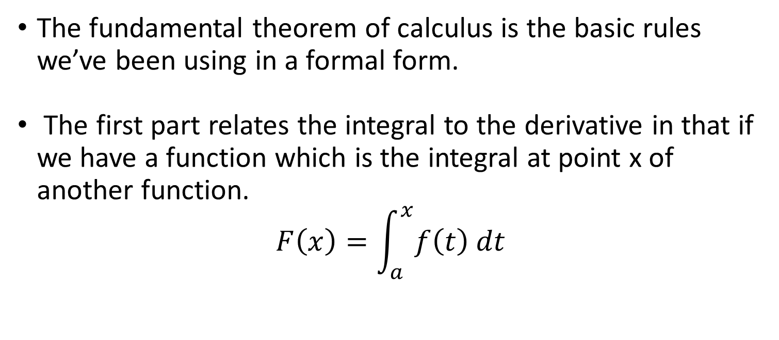
Fundamental Theorem of Calculus
The fundamental theorem of calculus is the basic rules we’ve been using in a formal form.
The first part relates the integral to the derivative in that if we have a function which is the integral at point x of another function.
$$F\left(x\right)=\int_{a}^{x}{f\left(t\right) dt}$$

Slide 36
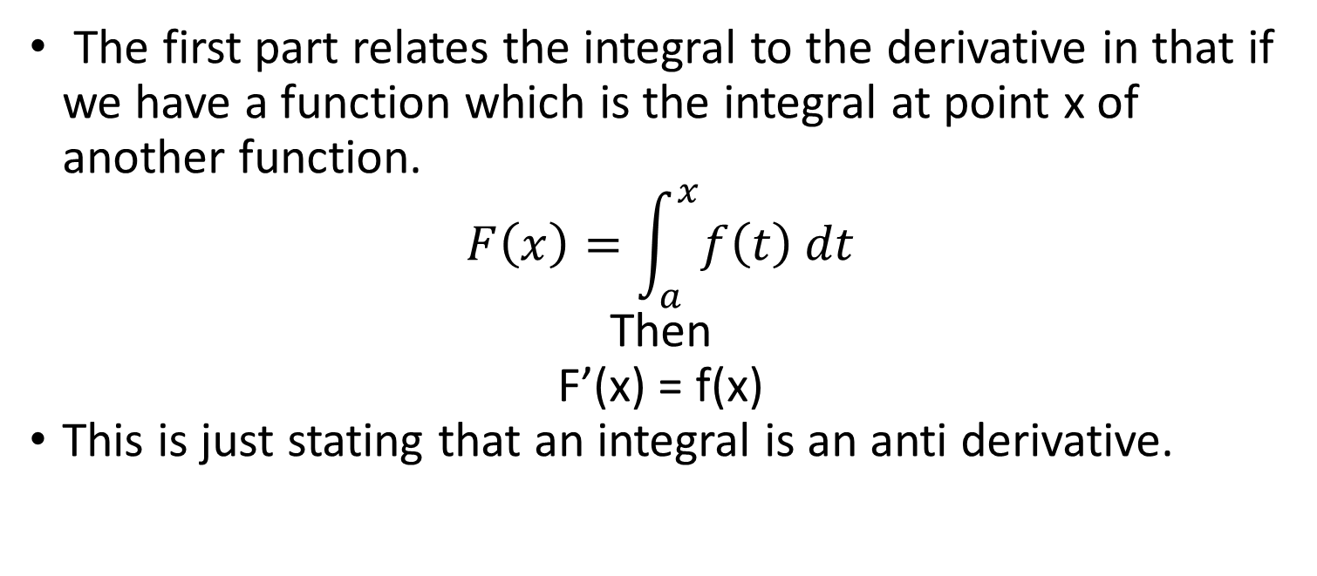
Fundamental Theorem of Calculus
The first part relates the integral to the derivative in that if we have a function which is the integral at point x of another function.
$$F\left(x\right)=\int_{a}^{x}{f\left(t\right) dt}$$
Then
F’(x) = f(x)
This is just stating that an integral is an anti derivative.

Slide 37
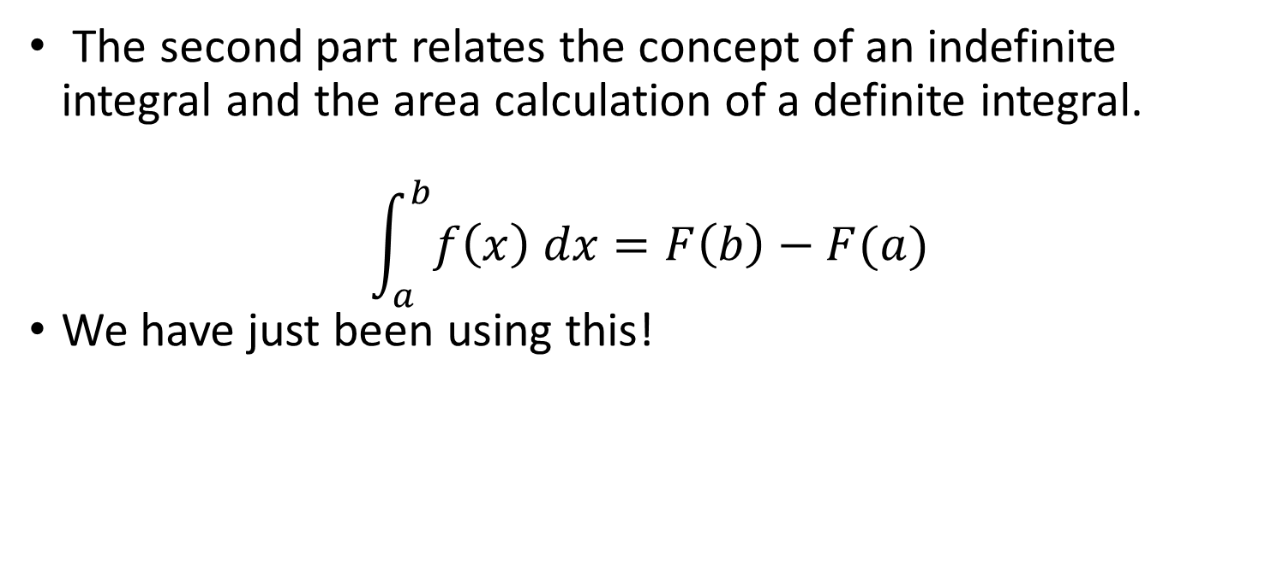
Fundamental Theorem of Calculus
The second part relates the concept of an indefinite integral and the area calculation of a definite integral.
$$\int_{a}^{b}{f\left(x\right) dx}=F\left(b\right)−F(a)$$
We have just been using this!

